Slide 1









My Algebra Interactive Notebook
$$×$$
$$\frac{1}{2}$$
$$÷$$
$$+$$
$$−$$
$$\frac{3}{5}$$
$$7$$
Name
Class
Teacher
Term 1 Semester 1
$$5^{2}$$
$$\sqrt{9}$$
1

Slide 2
Contents
Glossary or Formula Page
Page
Date
Description
2
3

Slide 3
Tasks
24
7
30
Essential Question
Questions
Notes
Summary
6
7

Slide 4
24
7
30
Date
Add - Subtract Algebraic Fractions
EQ – How do I Simplify when Adding & Subtracting Algebraic Fractions?
7

Slide 5
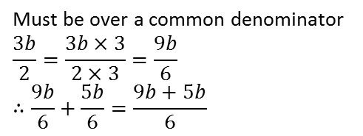
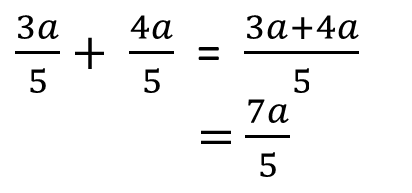
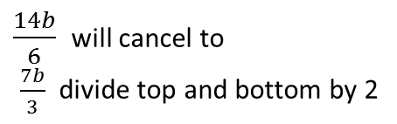
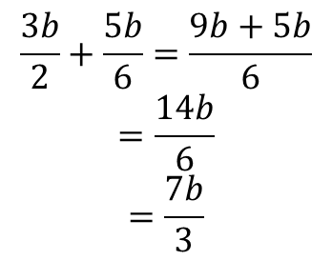
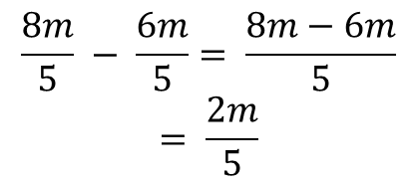
24
7
30
Date
Add - Subtract Algebraic Fractions
EQ – How do I Simplify when Adding & Subtracting Algebraic Fractions?
Add?
$\frac{3a}{5}+ \frac{4a}{5}$ = $\frac{3a+4a}{5}$
= $\frac{7a}{5}$
Don’t forget you must have a common denominator, then add the top line.
Note: don’t make it a mixed numeral
$$\frac{8m}{5} − \frac{6m}{5}= \frac{8m−6m}{5}$$
$$= \frac{2m}{5}$$
Similar to Addition don’t forget you must have a common denominator, then subtract the the top line.
Subtract?
Common
denominator?
Must be over a common denominator
$$\frac{3b}{2}=\frac{3b×3}{2×3}=\frac{9b}{6}$$
$$∴\frac{9b}{6}+\frac{5b}{6}=\frac{9b+5b}{6}$$
$$\frac{3b}{2}+\frac{5b}{6}=\frac{9b+5b}{6}$$
$$=\frac{14b}{6}$$
$$=\frac{7b}{3}$$
$\frac{14b}{6}$ will cancel to
$\frac{7b}{3}$ divide top and bottom by 2

Slide 6
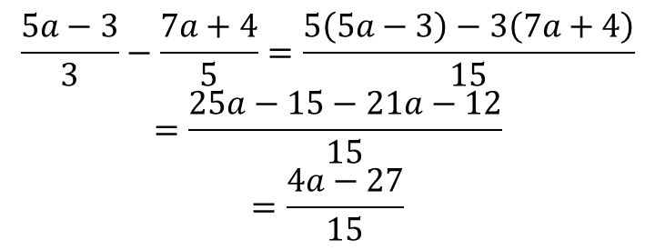
24
7
30
Date
Add - Subtract Algebraic Fractions
EQ – How do I Simplify when Adding & Subtracting Algebraic Fractions?
Harder example?
$$\frac{5a−3}{3}−\frac{7a+4}{5}=\frac{5\left(5a−3\right)−3\left(7a+4\right)}{15}$$
$$=\frac{25a−15−21a−12}{15}$$
$$=\frac{4a−27}{15}$$
Doesn’t matter + or - it must have a common denominator.
Then multiply out the top line and of course simplify!! Easy isn’t it lol.
7

Slide 7
Exercises
Exercise 1.7 from Dwyer
All to be done with a smile on your faces.

Slide 8
24
7
30
Date
Multiply – Divide Algebraic Fractions
EQ – How do I Simplify when Multiplying & Dividing Algebraic Fractions?
7

Slide 9
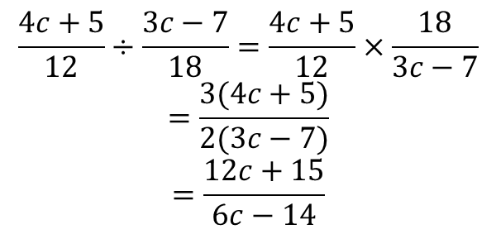
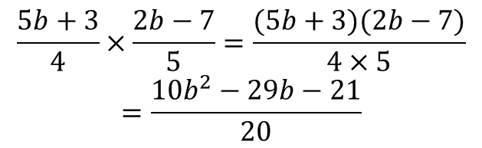
24
7
30
Date
Multiply – Divide Algebraic Fractions
EQ – How do I Simplify when Multiplying & Dividing Algebraic Fractions?
Multiply?
$$\frac{4ab}{3}×\frac{6bc}{5}=\frac{8ab^{2}c}{5}$$
The 3 on the bottom will cancel with the 6 on the top and then multiply the top line then the bottom line.
$$\frac{6cd^{2}}{7}÷\frac{12c}{21}=\frac{6cd^{2}}{7}×\frac{21}{12c}$$
$$=\frac{3d^{2}}{2}$$
Similar to Multiplication but you must first invert (tip upside down) the divisor then cancel.
Divide?
$$\frac{5b+3}{4}×\frac{2b−7}{5}=\frac{(5b+3)(2b−7)}{4×5}$$
$$=\frac{10b^{2}−29b−21}{20}$$
$$\frac{4c+5}{12}÷\frac{3c−7}{18}=\frac{4c+5}{12}×\frac{18}{3c−7}$$
$$=\frac{3(4c+5)}{2(3c−7)}$$
$$=\frac{12c+15}{6c−14}$$
Invert the divisor cancel the 18 and 12, then multiply.
There is nothing to cancel so multiply top line together and bottom line together

Slide 10
Exercises
Exercise 1.8 from Dwyer
All to be done with a smile on your faces.

Slide 11
Notes Review
24, 7 ,30
Date
Title
Essential question
Notes complete
Notes complete with colour and diagrams
Questions completed
Contents page filed in
Formula page filled in

Slide 12
Homework
Review your notes and write a summary answering the essential question.

